Slide 1

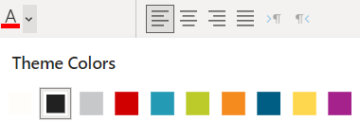
Template Tips
This slide is for guidance and should be removed from the PowerPoint when the build is complete.
This Template meets UNL brand standards and provides users with an easy way to create on-brand presentations. Below are some tips that will make building the presentation a little easier.
The default fonts are acceptable and available across all Microsoft Office products.
UNL’s color pallet is built into the template color theme. >
When inserting a graph, chart, table, etc., it will automatically be styled according to brand standards. To adjust colors, use the built-in color theme.
Slide numbers will automatically be included as slides are added. You can override this function if desired. Intro, Outro, Title and Section Title slides do not have page numbers.
Using the Icons function in the Insert tab is an easy way to include consistent icons throughout a presentation.
If inserting a photo with a transparent background into a grey placeholder block, you can remove the grey background color in the Shape Format tab.
A variety of slide layouts can be found in the New Slide drop down menu in the Home or Insert tabs.

